Slide 1
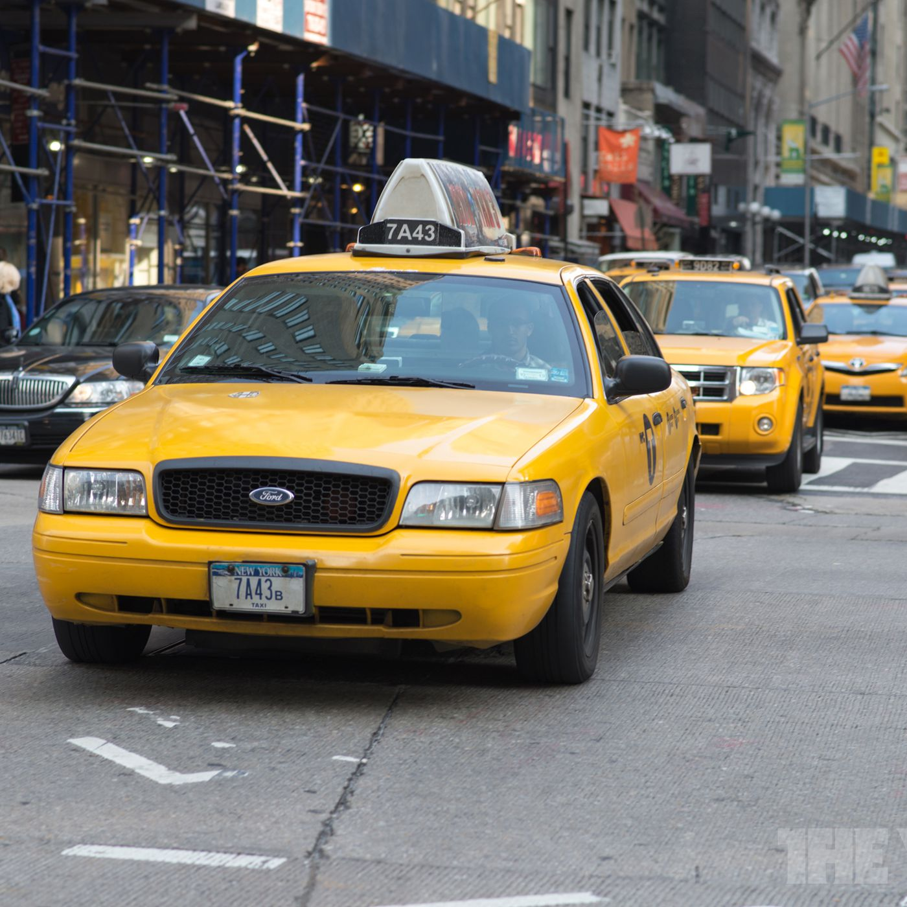
Yellow Taxi fare predictor
Group 11
Aayush Amit Patil
Akash Tirupapuliyur Srikanth
Notes:
NOTE: Want a different image on this slide? Select the picture and delete it. Now click the Pictures icon in the placeholder to insert your own image.

Slide 2
AGENDA
Introduction
Knowing our data and Business Case
Modules used
Exploratory Data Analysis
Predictive model
Graphical User Interface

Slide 3
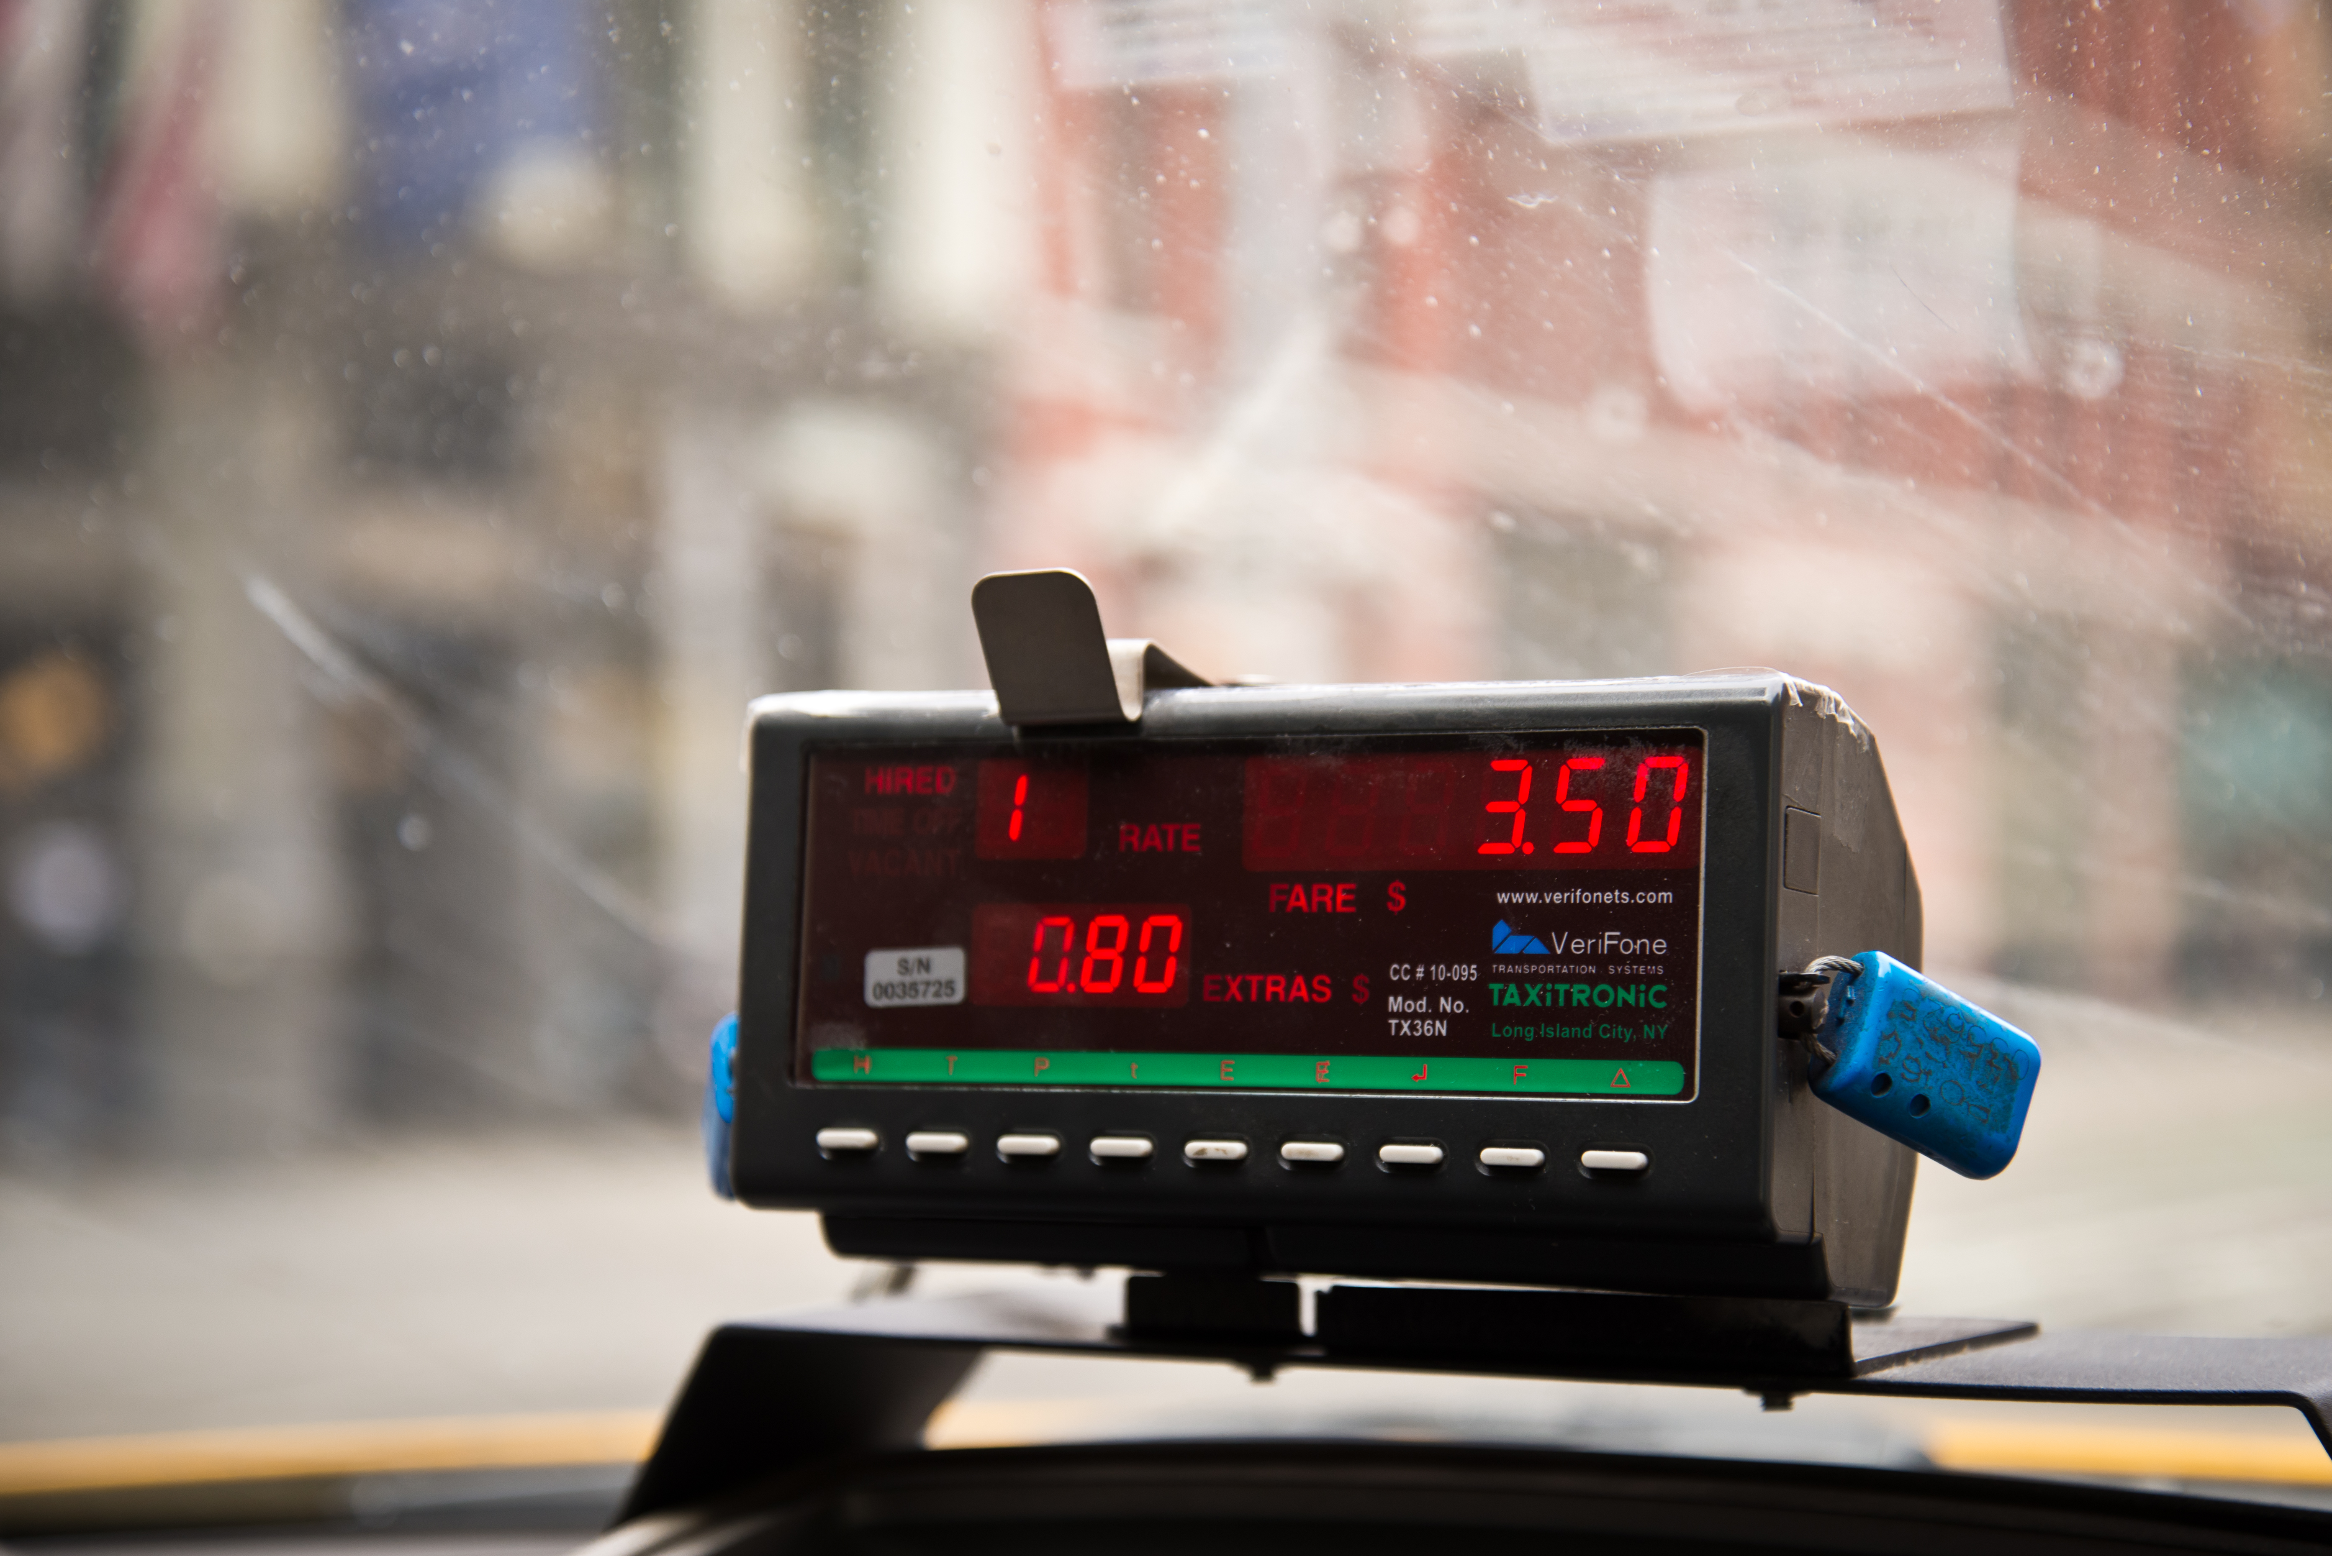
INTRODCUTION
Yellow taxi have been the heart of NYC.
Iconic symbol and cultural identity.
Economic Contribution and Reliability.
24/7 accessibility and tourism impact.

Slide 4
KNOWING OUR DATA AND BUSINESS CASE
Datasets
Yellow taxi trip data : A dataset from which we use 2 million rows to train our model. The dataset consists 24 columns. From NYC Open Data
Taxi lookup table : This is a support data set which is used to get the name of zones and borough from the Location ID in the Yellow taxi trip datasets.
Business Case ​
We Look forward to predict the Yellow Taxi Fare.

Slide 5
MODULES USED
For Data Importing and preprocessing:
pandas
numpy
sodapy
Datetime
For Machine Learning Models:
sklearn
For GUI development:
tkinter
For Distance mapping:
geopy

Slide 6
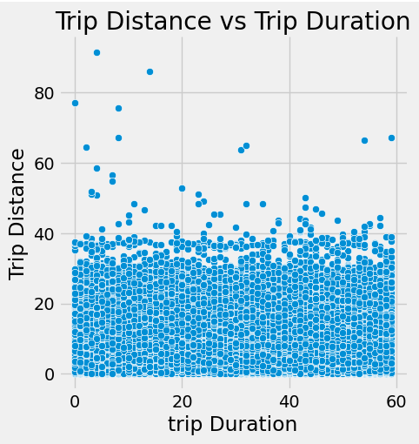
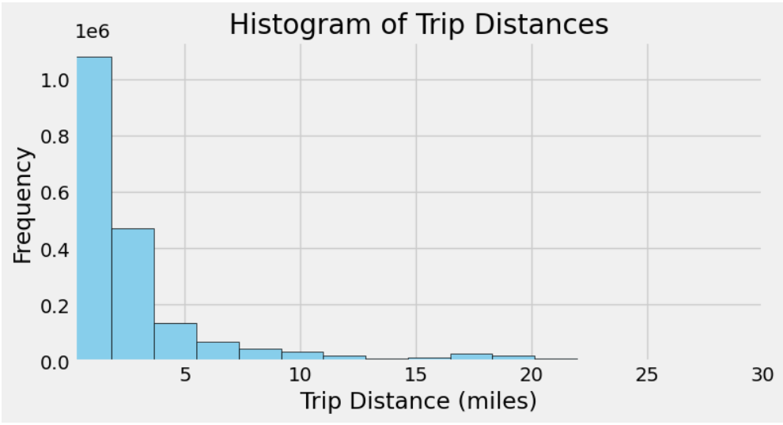
EXPLORATORY DATA ANALYSIS
Trip Duration vs Trip Distance
Frequency distribution of Trip distance

Slide 7
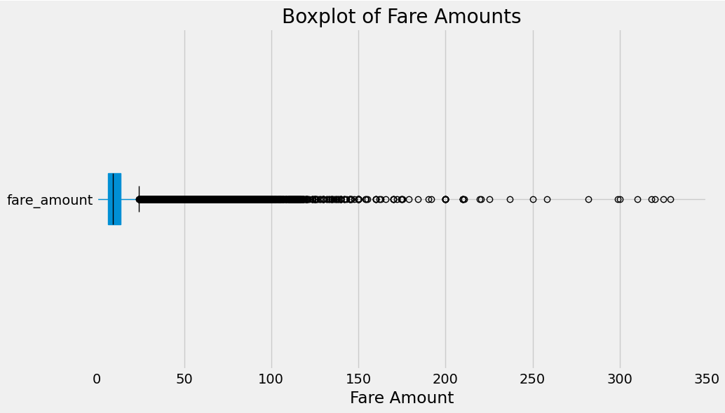
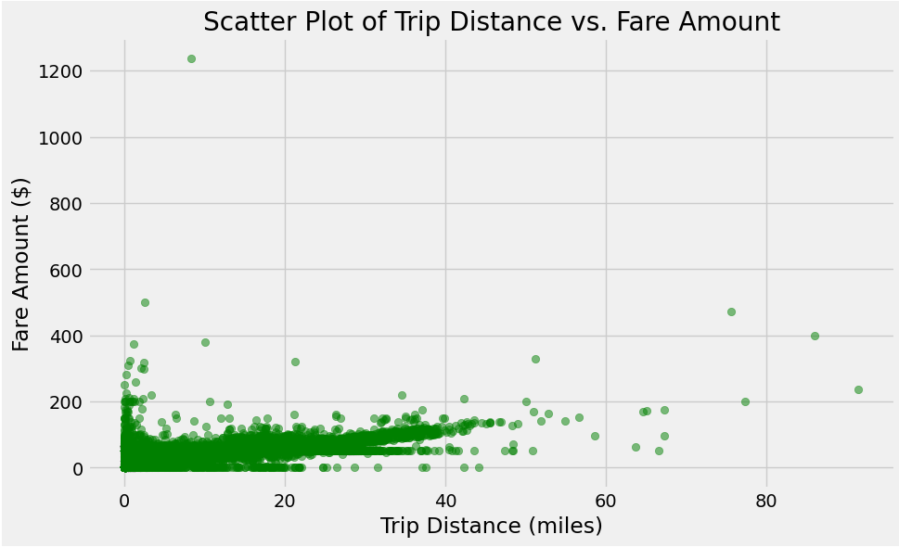
EXPLORATORY DATA ANALYSIS
Box plot showing Fare Amount distribution
Scatter plot of Trip Distance Vs. Fare Amount

Slide 8
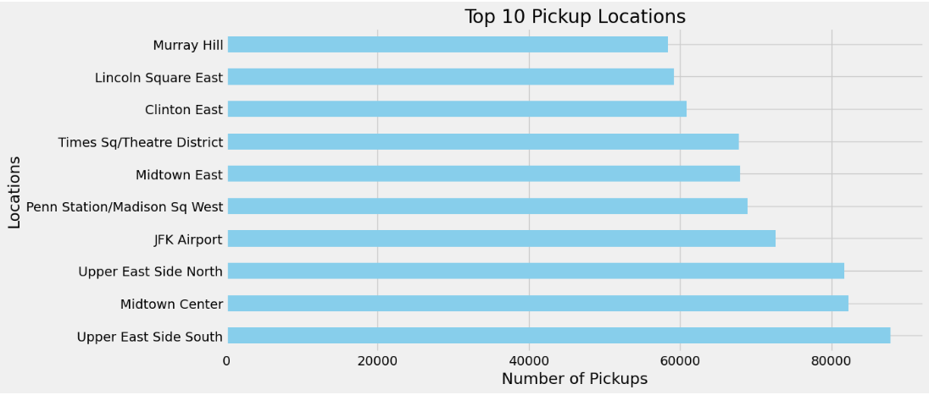
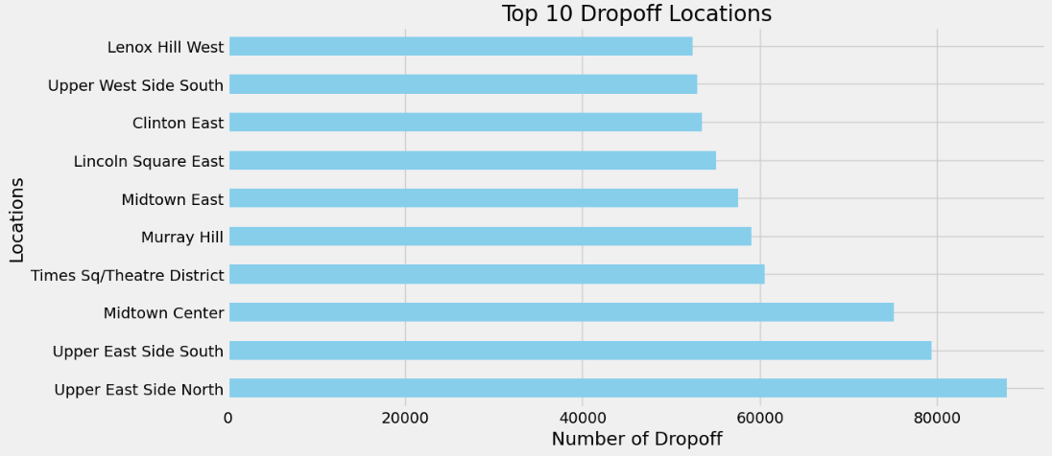
EXPLORATORY DATA ANALYSIS
Top 10 Pickup Locations
Top 10 Drop-off Locations

Slide 9
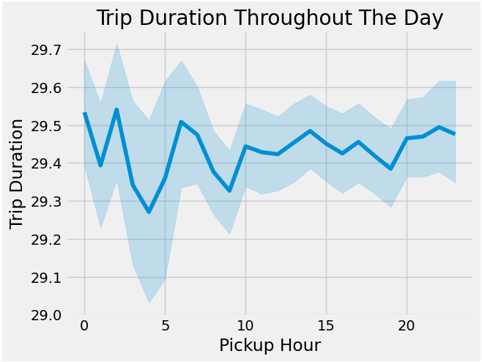
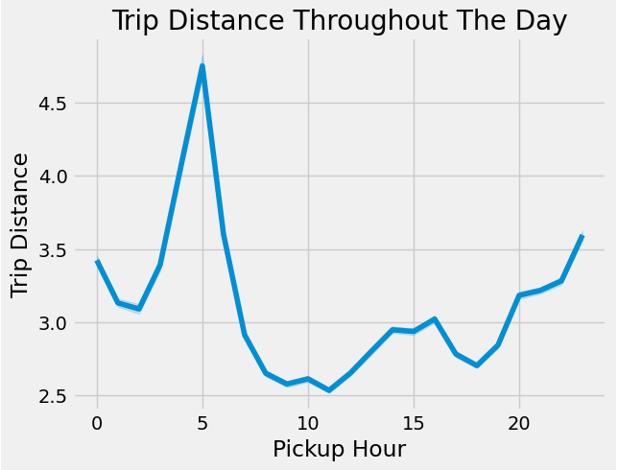
EXPLORATORY DATA ANALYSIS
Distribution of trip duration according to pick-up hour
Distribution of trip distance according to pick-up hour

Slide 10
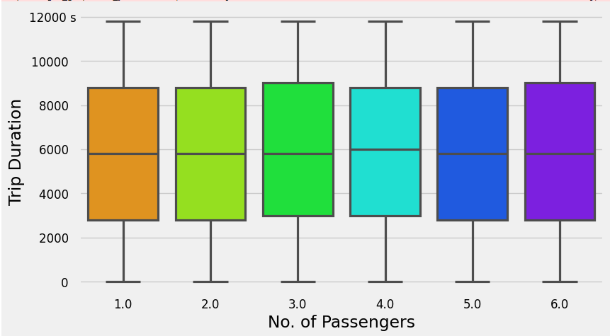
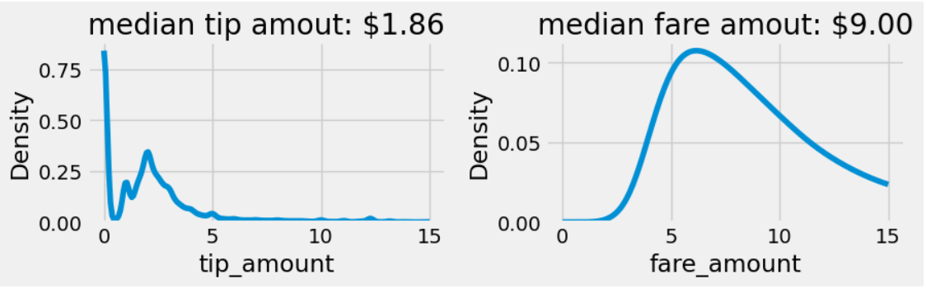
EXPLORATORY DATA ANALYSIS
Distribution of Fare and tip amount
Boxplot showing Median of Trip duration as per passenger count

Slide 11
PREDICTIVE MODEL
Features
Split
Pickup Location ID
Dropoff Location ID
Distance
Weekday
Pickup time
We Split the data into 80% train and 20% test data.

Slide 12
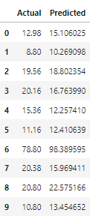
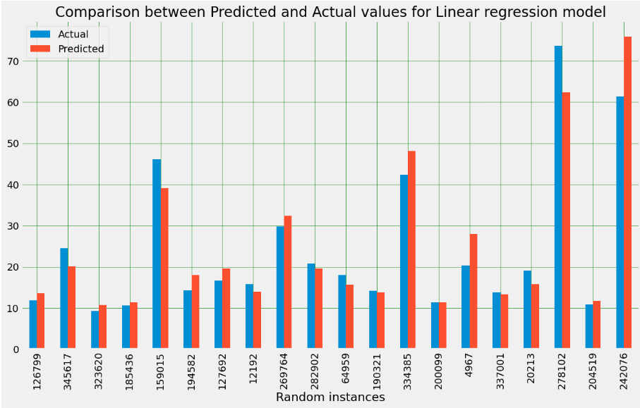
PREDICTIVE MODEL
Linear Regression Model
Accuracy: 86.02%

Slide 13
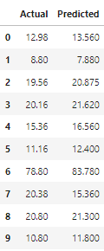
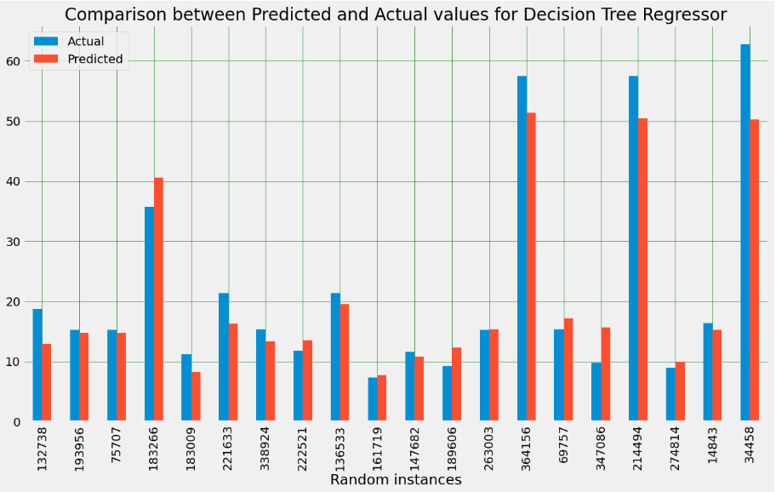
PREDICTIVE MODEL
Decision Tree Regressor
Accuracy: 75.72%

Slide 14
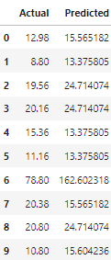
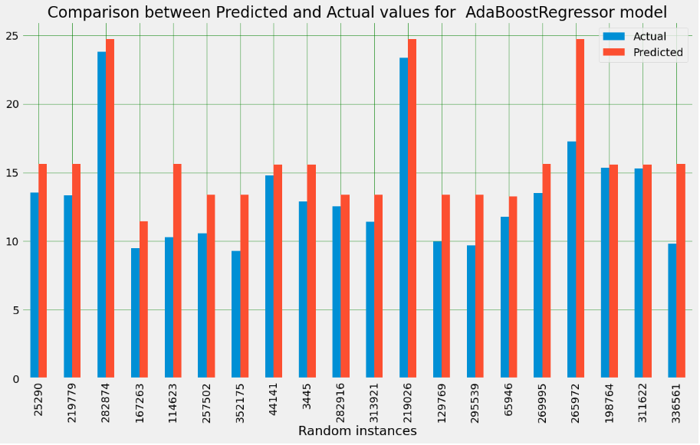
PREDICTIVE MODEL
ADA Boost Regressor
Accuracy: 74.64%

Slide 15
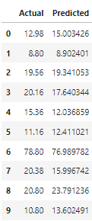
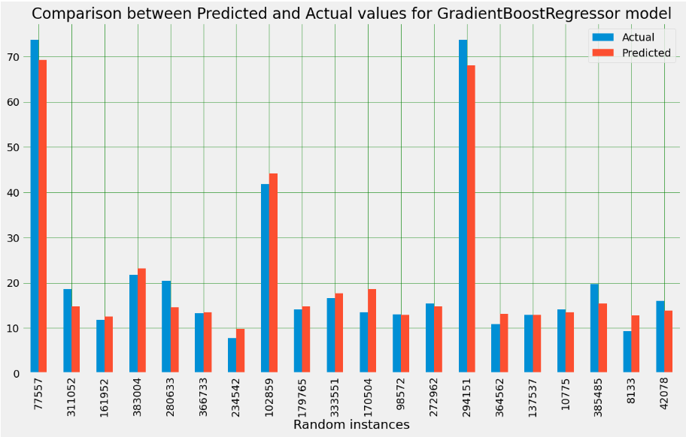
PREDICTIVE MODEL
Gradient Boost Regressor
Accuracy: 89%

Slide 16
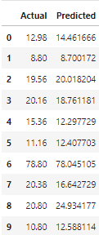
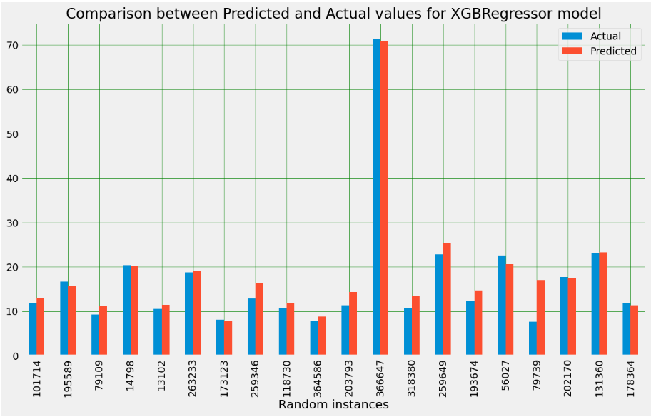
PREDICTIVE MODEL
XGB Regressor
Accuracy: 90.69%

Slide 17
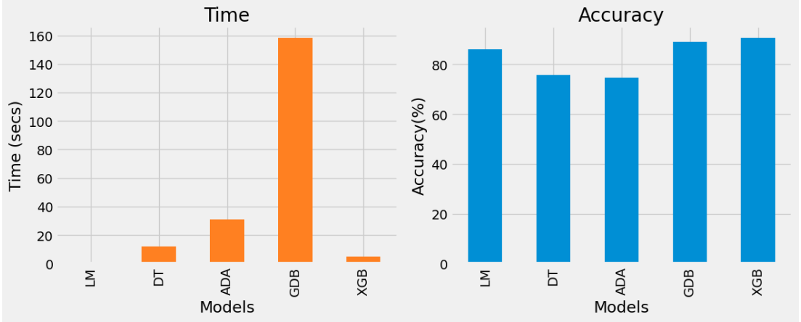
PREDICTIVE MODEL
When we compare Time and Accuracy we can see that the XGB Regressor is the clear choice

Slide 18
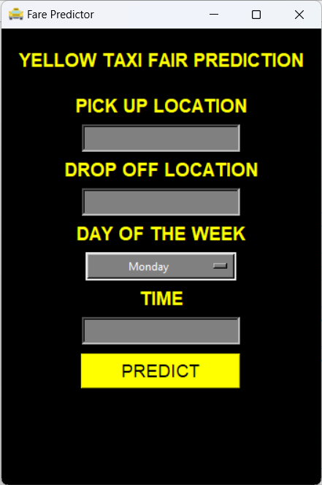
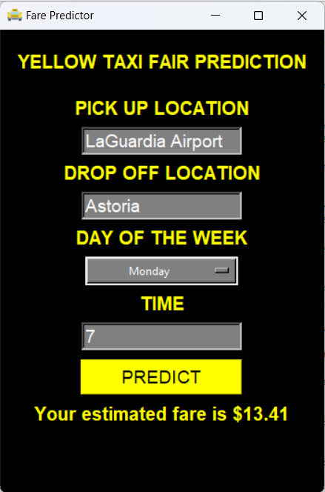

GRAPHICAL USER INTERFACE (GUI)

Slide 19
THANK YOU

